Slide 1

Welcome to the Riot API Bootcamp!
Know more, win more.

Slide 2








What is the purpose of this course?
Learning to use the Riot API is a bit of a struggle. There's very few resources out there and they're not very structured.
“The Riot API Bootcamp Course is designed to take you from no knowledge up to building your own app.”

Slide 3




Who am i?
Karl, Rocket Scientist & Data Analyst
Past work and collaborations:
Cloud 9
NASA
Wells Fargo
Mozilla
Lockheed Martin
Air Force Research Lab
Siemens, GSK
Experience in everything from AI/ML to jet engine design
“Solve difficult problems with novel methods, by any means necessary”
RebirthNA#2359
@LoL-Genius
417devops@gmail.com

Slide 4
Bootcamp syllabus
Basics (Python, GitHub, Notepad++)
Resources to get started
Setting up an environment
Downloading GitHub repos
JSON explanation & Notepad++ example
Project: read csv file, convert to data frame, create graphs
Riot API introduction
What is an API?
Getting access & Registering your App
What end points are there/what data is available?
Explanation of puuid/account name
Project: make an API call on the website & download the data
Automating API interactions
Introduction to libraries (Cassiopeia, Riot Watcher)
Getting help (documentation, Discord)
Project: automate an API call using a library
Single Endpoint Data
Use case explanation (e.g., in-depth match analysis, leaderboards)
Code example- getting challenger leaderboard
Project: request last 25 games for an account and determine the most common champion(s)
Large Scale Data Collection
Use case explanation (e.g., match history of top 50 players)
Setting up a process pipeline
Comparing 1 file approach vs. functions across files approach
Project: determine number of roles (TOP, MID, etc) on the challenger ladder using the last 5 games
5 Modules covering core topics Project at the end of each

Slide 5
Module 3: Automating API interactions
Riot API BOOTCAMP
Slide Deck

Slide 6

Module 3: Automation
Automating API interactions
Introduction to libraries (Cassiopeia, Riot Watcher)
Getting help (documentation, Discord)
Project: automate an API call using a library
Let’s Dive In

Slide 7
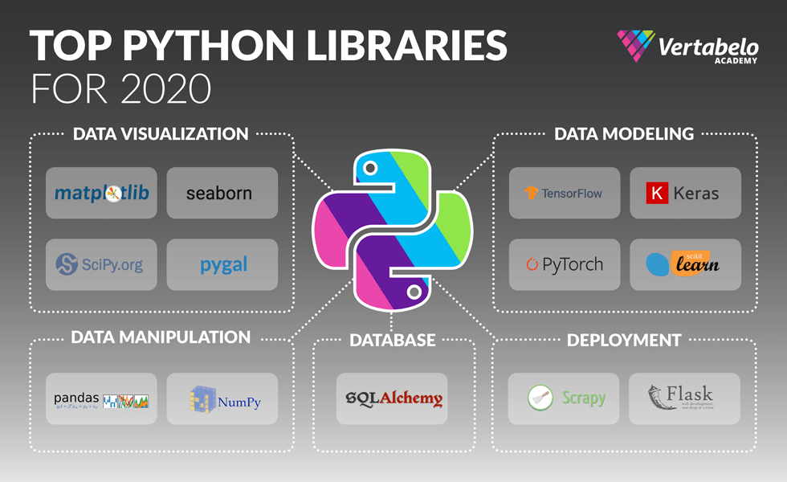
What are python libraries?
A library is a collection of books or is a room or place where many books are stored to be used later.
Similarly, in the programming world, a library is a collection of precompiled codes that can be used later in a program for some specific well-defined operations.
Example: pandas let us preform a bunch of operations on a dataset

Slide 8
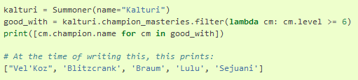
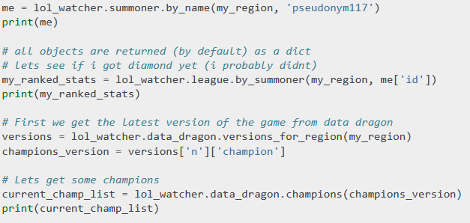
Libraries for the riot api
Getting champion mastery with the Cassiopeia library
Thankfully, people have written libraries that allow us to automate Riot API interactions!
Each programming language has its own version
Simplifies complicated requests into short code bits
Checking competitive match rank with Riot Watch library

Slide 9
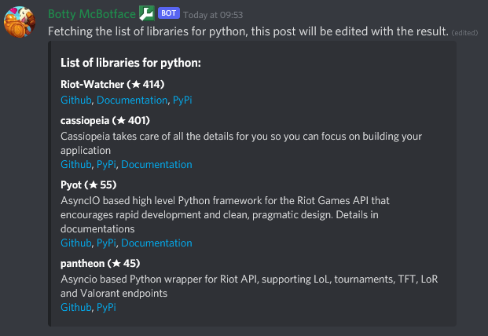
Popular riot api Python Libraries
Riot Watcher
Least buggy
Supports different Riot games
https://github.com/pseudonym117/Riot-Watcher
Cassiopeia
Easiest to use
Web-based integrations
https://github.com/meraki-analytics/cassiopeia
Pyot
AsyncIO based
Does not support DDragon
https://github.com/paaksing/Pyot
Pantheon
Simpler Pyot
Supports most endpoints
https://github.com/Canisback/pantheon

Slide 10
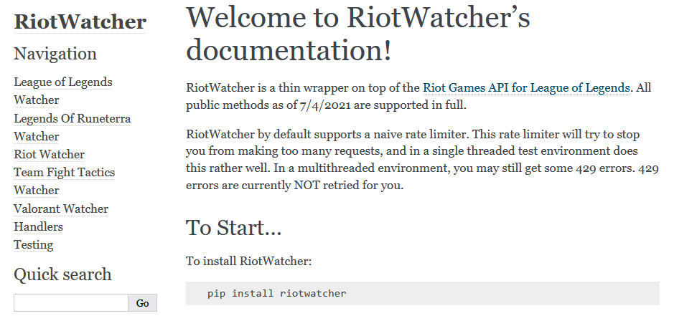
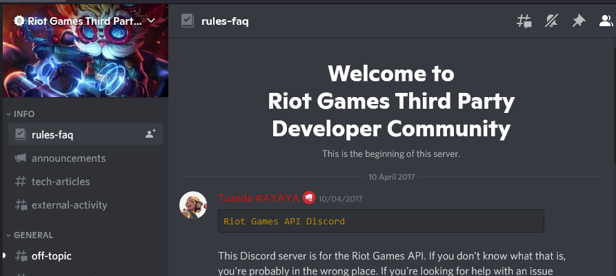
Where to get help
Each library has its own documentation explaining what different functions do
The code documentation also has examples!
Because the Riot API community is relatively small, searching the internet if you have a problem doesn’t really help.
Check out the Riot Games Developer discord server: https://discord.gg/riotgamesdevrel
You can also reach out to me or others in the community if you have questions!

Slide 11
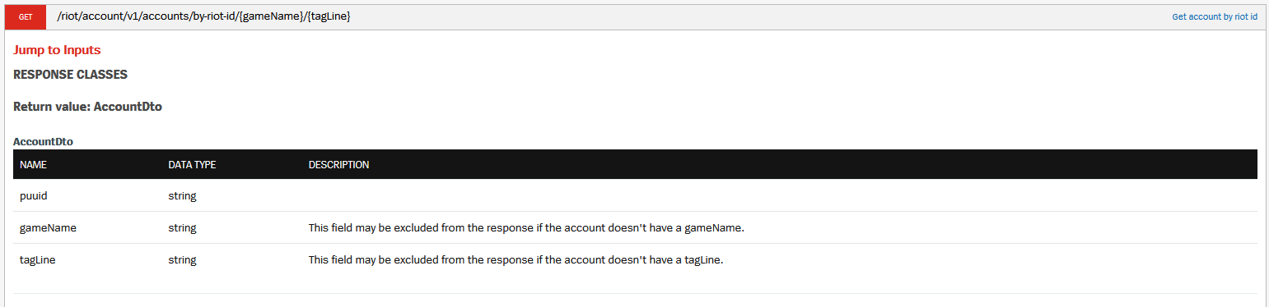
Automating an API request
DEMONSTRATION with
/riot/account/v1/accounts/by-riot-id/{gameName}/{tagLine}
Same as Module 2, but now with code

Slide 12

Project-3 Info
Task List:
Automate an API call using a library
Save and play around with the data!
Let’s Dive In

Slide 13


Questions?
Contact me
It is my hope that this course is easy to understand and follow
Have a question or want additional details? Just reach out!
If you want to know more about my work (LoL Genius) or have questions about something you’re building, LMK!

